Slide 1
Convolutional Neural Networks II
Jin Lu – UMDearborn

Slide 2
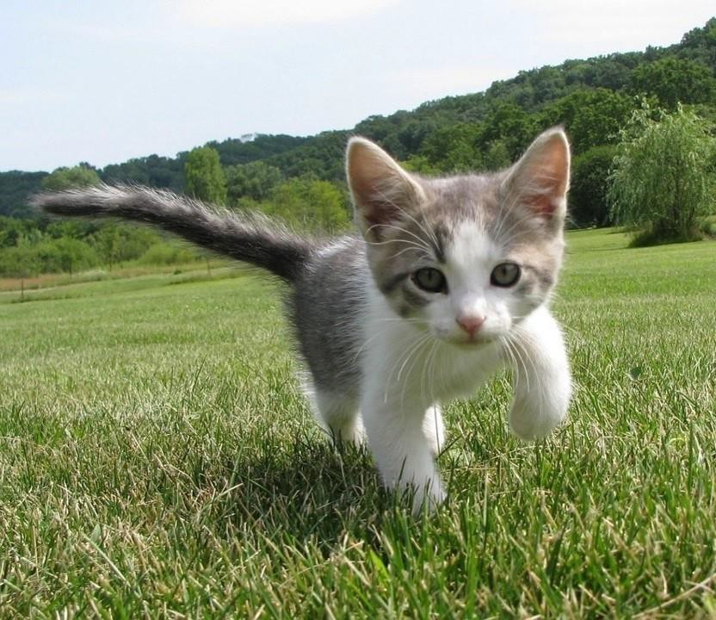
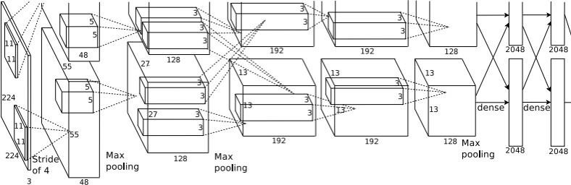
So far: Image Classification
Class Scores
Cat: 0.9
Dog: 0.05
Car: 0.01
...
Fully-Connected: 4096 to 1000
Vector:
4096
This image is CC0 public domain
Figure copyright Alex Krizhevsky, Ilya Sutskever, and
Geoffrey Hinton, 2012. Reproduced with permission.

Slide 3
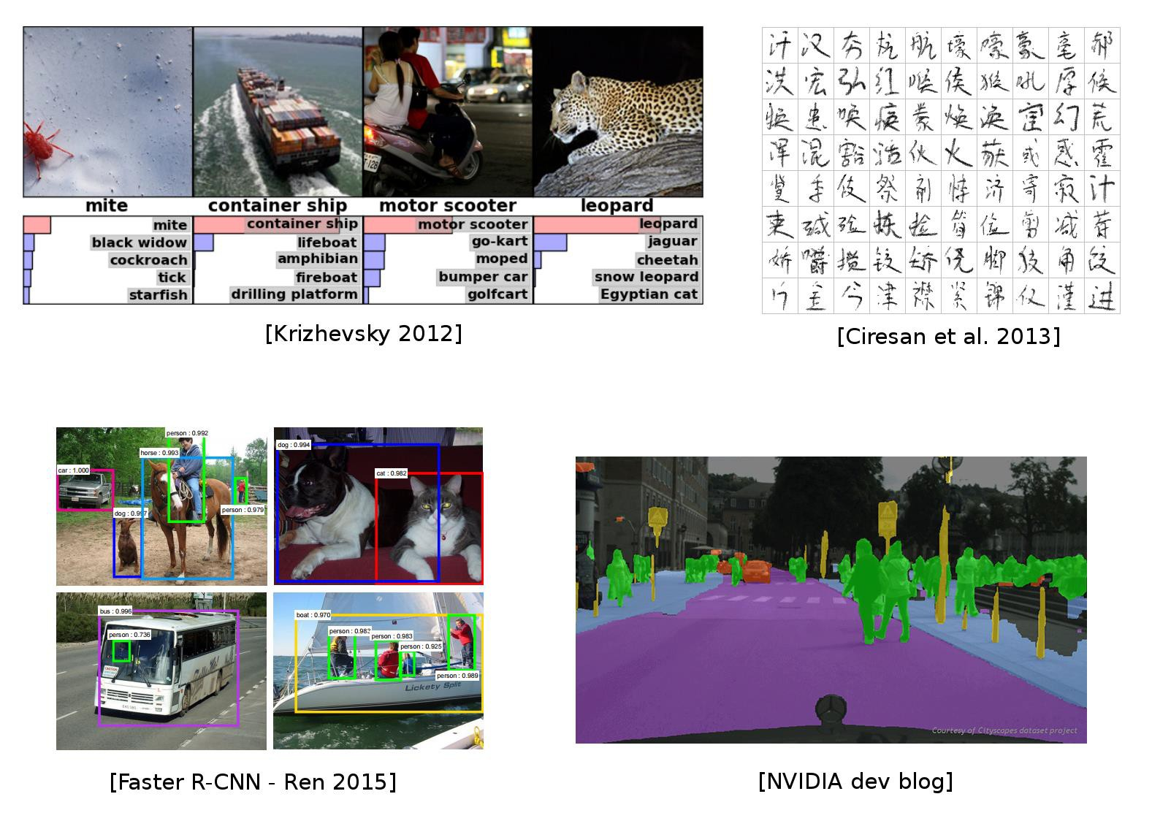
Used everywhere for Vision
Embeddings

Slide 4
Beyond Image Classification
CNNs
Previous lecture: image classification

Slide 5
Beyond Image Classification
CNNs
Previous lecture: image _{Li}c_{m}la_{i}s_{ta}si_{t}f_{i}i_{o}c_{n}a_{s}tion
Mostly on centered images
Only a single object per image
Not enough for many real world vision tasks

Slide 6
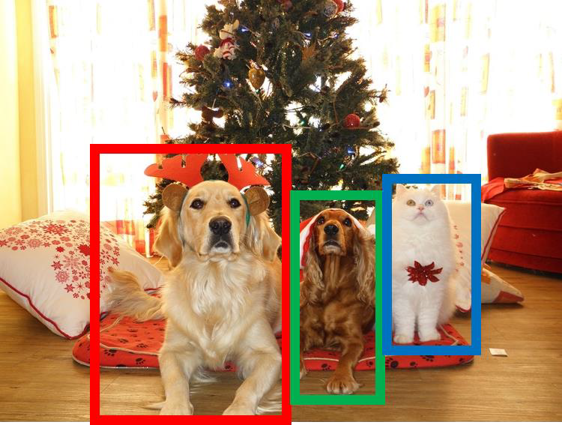
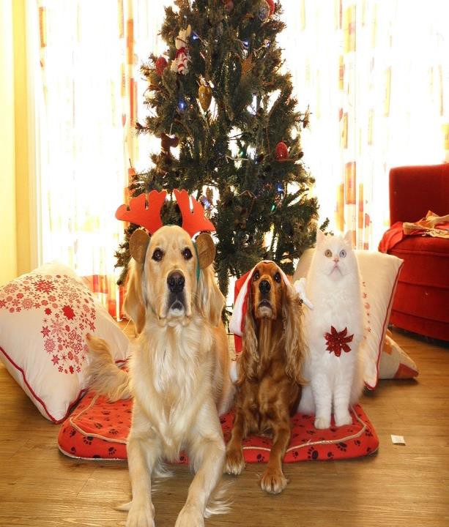
Computer Vision Tasks
Semantic
Object Detection
Instance Segmentation
Classification
Segmentation
CAT
GRASS, CAT, TREE,
SKY
DOG, DOG, CAT
DOG, DOG, CAT
No spatial extent
No objects, just pixels
Multiple Objects
This image is CC0 public domain

Slide 7
Today: Object Detection
Classification ^{Semantic} Segmentation
_{CAT} GRASS, CAT, TREE,
SKY
Object Detection
Instance
Segmentation
DOG, DOG, CAT
DOG, DOG, CAT
No spatial extent
No objects, just pixels
Multiple Objects
This image is CC0 public domain

Slide 8
Object Detection: Task Definition
Input: Single RGB Image
Output: A set of detected objects; For each object predict:
Category label (from fixed, known set of categories)
Bounding box (four numbers: x, y, width, height)

Slide 9
Object Detection: Challenges
Multiple outputs: Need to output variable numbers of objects per image
Multiple types of output: Need to
predict ”what” (category label) as well as “where” (bounding box)
Large images: Classification works at 224x224; need higher resolution for detection, often ~800x600

Slide 10
Detecting a single object
Vector:
4096
This image is CC0 public domain

Slide 11
Detecting a single object
“What”
Correct label:
Cat
Class Scores
Cat: 0.9
Dog: 0.05
Car: 0.01
...
Fully Connected: 4096 to 1000
Softmax
Loss
Vector:
4096
This image is CC0 public domain

Slide 12
Detecting a single object
“What”
Correct label:
Cat
Class Scores
Cat: 0.9
Dog: 0.05
Car: 0.01
...
Fully Connected: 4096 to 1000
Softmax
Loss
Vector:
4096
This image is CC0 public domain
Fully Connected: 4096 to 4
Treat localization as a
regression problem!
Box
Coordinates
L2 Loss
(x, y, w, h)
“Where”
Correct box:
(x’, y’, w’, h’)

Slide 13
Detecting a single object
“What”
Correct label:
Cat
Class Scores
Cat: 0.9
Dog: 0.05
Car: 0.01
...
Fully Connected: 4096 to 1000
Softmax
Loss
Weighted Sum
Loss
Vector:
4096
This image is CC0 public domain
Fully Connected: 4096 to 4
Treat localization as a
regression problem!
Box
Coordinates
L2 Loss
(x, y, w, h)
“Where”
Correct box:
(x’, y’, w’, h’)

Slide 14
Detecting a single object
“What”
Correct label:
Cat
Class Scores
Cat: 0.9
Dog: 0.05
Car: 0.01
...
Fully Connected: 4096 to 1000
Softmax
Loss
Multitask Loss
Loss
Weighted Sum
Vector:
4096
This image is CC0 public domain
Fully Connected: 4096 to 4
Treat localization as a
regression problem!
Box
Coordinates
L2 Loss
(x, y, w, h)
“Where”
Correct box:
(x’, y’, w’, h’)

Slide 15
Detecting a single object
“What”
Correct label:
Cat
Class Scores
Cat: 0.9
Dog: 0.05
Car: 0.01
...
Fully Connected: 4096 to 1000
Softmax
Loss
Often pretrained on ImageNet (Transfer learning)
Multitask Loss
Loss
Weighted Sum
Vector:
4096
This image is CC0 public domain
Fully Connected: 4096 to 4
Treat localization as a
regression problem!
Box
Coordinates
L2 Loss
(x, y, w, h)
“Where”
Correct box:
(x’, y’, w’, h’)

Slide 16
Detecting a single object
“What”
Correct label:
Cat
Class Scores
Cat: 0.9
Dog: 0.05
Car: 0.01
...
Fully Connected: 4096 to 1000
Softmax
Loss
Often pretrained on ImageNet (Transfer learning)
Multitask Loss
Loss
Weighted Sum
Vector:
4096
This image is CC0 public domain
Fully Connected: 4096 to 4
Treat localization as a
regression problem!
Box Coordinates (x, y, w, h)
L2 Loss
Problem: Images can have more than one object!
“Where”
Correct box:
(x’, y’, w’, h’)
Notes:
Box coordinates = bounding box

Slide 17

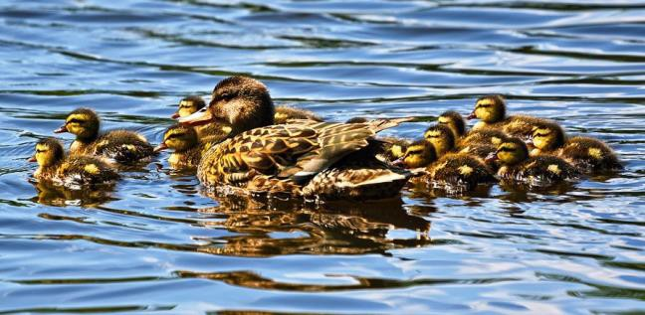
Need different numbers of outputs per image
Detecting Multiple Objects
CAT: (x, y, w, h)
4 numbers
DOG: (x, y, w, h)
DOG: (x, y, w, h)
CAT: (x, y, w, h)
12 numbers
DUCK: (x, y, w, h)
DUCK: (x, y, w, h)
….
Many
numbers!
Duck image is free to useunder the Pixabay license

Slide 18
Detecting Multiple Objects: Sliding Window
Apply a CNN to many different crops of the image, CNN classifies each crop as object or background
Dog? NO
Cat? NO
Background? YES

Slide 19
Detecting Multiple Objects: Sliding Window
Apply a CNN to many different crops of the image, CNN classifies each crop as object or background
Dog? YES
Cat? NO Background? NO

Slide 20
Detecting Multiple Objects: Sliding Window
Apply a CNN to many different crops of the image, CNN classifies each crop as object or background
Dog? YES
Cat? NO Background? NO

Slide 21
Detecting Multiple Objects: Sliding Window
Apply a CNN to many different crops of the image, CNN classifies each crop as object or background
Dog? NO Cat? YES
Background? NO

Slide 22
Detecting Multiple Objects: Sliding Window
Apply a CNN to many different crops of the image, CNN classifies each crop as object or background
Question: How many possible boxes
are there in an image of size H x W?

Slide 23
Detecting Multiple Objects: Sliding Window
Apply a CNN to many different crops of the image, CNN classifies each crop as object or background
Question: How many possible boxes
are there in an image of size H x W?
Consider a box of size h x w: Possible x positions: W – w + 1 Possible y positions: H – h + 1 Possible positions:
(W – w + 1) * (H – h + 1)

Slide 24
Detecting Multiple Objects: Sliding Window
Apply a CNN to many different crops of the image, CNN classifies each crop as object or background
Question: How many possible boxes
are there in an image of size H x W?
Total possible boxes:
Consider a box of size h x w: Possible x positions: W – w + 1 Possible y positions: H – h + 1
𝑊 𝐻
෍ ෍
𝑊 − 𝑤 + 1 × ( 𝐻 − ℎ + 1 )
𝑤 = 1 ℎ = 1
Possible positions:
(W – w + 1) * (H – h + 1)
𝐻(𝐻 + 1) 𝑊(𝑊 + 1)
=
2
2

Slide 25
Detecting Multiple Objects: Sliding Window
800 x 600 image has ~58M boxes! No way we can evaluate them all
Apply a CNN to many different crops of the image, CNN classifies each crop as object or background
Question: How many possible boxes
are there in an image of size H x W?
Total possible boxes:
Consider a box of size h x w: Possible x positions: W – w + 1 Possible y positions: H – h + 1
𝑊 𝐻
෍ ෍
𝑊 − 𝑤 + 1 × ( 𝐻 − ℎ + 1 )
𝑤 = 1 ℎ = 1
Possible positions:
(W – w + 1) * (H – h + 1)
𝐻(𝐻 + 1) 𝑊(𝑊 + 1)
=
2
2

Slide 26
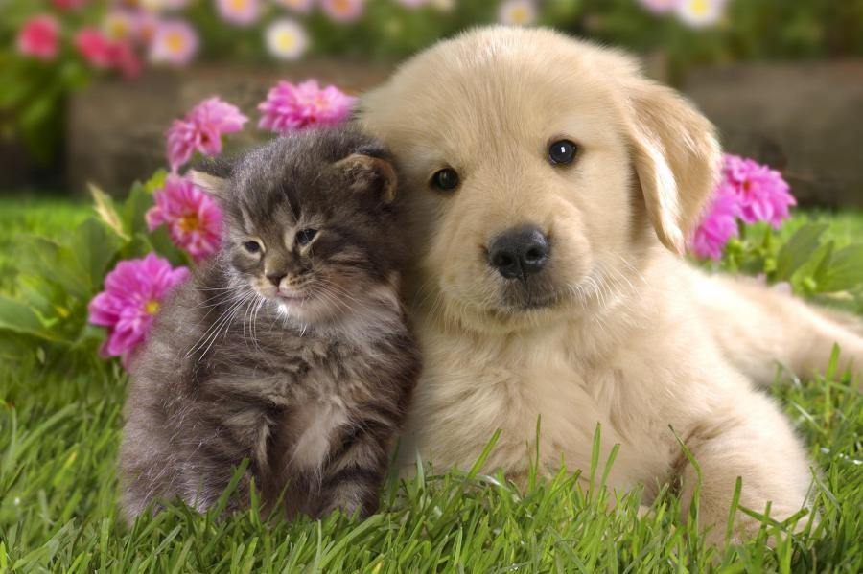
Region Proposals
Find a small set of boxes that are likely to cover all objects
Often based on heuristics: e.g. look for “blob-like” image regions
Relatively fast to run; e.g. Selective Search gives 2000 region
proposals in a few seconds on CPU
Alexe et al, “Measuring the objectness of image windows”, TPAMI 2012
Uijlings et al, “Selective Search for Object Recognition”, IJCV 2013
Cheng et al, “BING: Binarized normed gradients for objectness estimation at 300fps”, CVPR 2014
Zitnick and Dollar, “Edge boxes: Locating object proposals from edges”, ECCV 2014

Slide 27
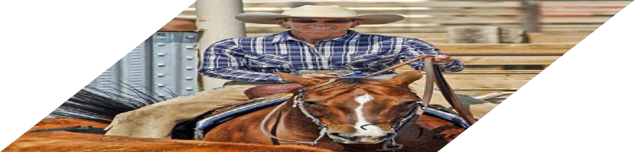
R-CNN: Region-Based CNN
Input
image
Girshick et al, “Rich feature hierarchies for accurate object detection and semantic segmentation”, CVPR 2014.
Figure copyright Ross Girshick, 2015; source. Reproduced with permission.

Slide 28
R-CNN: Region-Based CNN
Regions of
Interest (RoI) from a proposal
method (~2k)
Input
image
Girshick et al, “Rich feature hierarchies for accurate object detection and
semantic segmentation”, CVPR 2014.
Figure copyright Ross Girshick, 2015; source. Reproduced with permission.

Slide 29
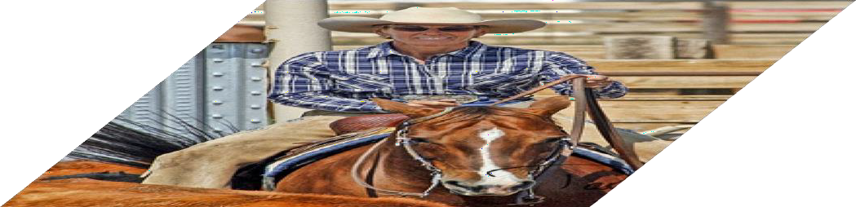
R-CNN: Region-Based CNN
Warped image regions (224x224)
Regions of
Interest (RoI) from a proposal
method (~2k)
Input
image
Girshick et al, “Rich feature hierarchies for accurate object detection and
semantic segmentation”, CVPR 2014.
Figure copyright Ross Girshick, 2015; source. Reproduced with permission.

Slide 30
R-CNN: Region-Based CNN
Conv Net
Forward each region through ConvNet
Conv
Net
Conv Net
Warped image regions (224x224)
Regions of
Interest (RoI) from a proposal
method (~2k)
Input
image
Girshick et al, “Rich feature hierarchies for accurate object detection and
semantic segmentation”, CVPR 2014.
Figure copyright Ross Girshick, 2015; source. Reproduced with permission.

Slide 31
R-CNN: Region-Based
Classify each region
CNN
Class
Class
Class
Forward each region through ConvNet
Conv Net
Conv
Net
Conv Net
Warped image regions (224x224)
Regions of
Interest (RoI) from a proposal
method (~2k)
Input
image
Girshick et al, “Rich feature hierarchies for accurate object detection and
semantic segmentation”, CVPR 2014.
Figure copyright Ross Girshick, 2015; source. Reproduced with permission.

Slide 32
R-CNN: Region-Based
Classify each region
CNN
Bounding box regression:
Predict “transform” to correct the
RoI: 4 numbers (t_{x}, t_{y}, t_{h}, t_{w})
Bbox
Class
Bbox
Class
Bbox
Class
Forward each region through ConvNet
Conv Net
Conv
Net
Conv Net
Warped image regions (224x224)
Regions of
Interest (RoI) from a proposal
method (~2k)
Input
image
Girshick et al, “Rich feature hierarchies for accurate object detection and
semantic segmentation”, CVPR 2014.
Figure copyright Ross Girshick, 2015; source. Reproduced with permission.

Slide 33
R-CNN: Region-Based
Classify each region
CNN
Bounding box regression:
Predict “transform” to correct the
RoI: 4 numbers (t_{x}, t_{y}, t_{h}, t_{w})
Bbox
Class
Bbox
Class
Bbox
Class
Forward each region through ConvNet
Conv Net
Region proposal: (p_{x}, p_{y}, p_{h}, p_{w})
Transform: (t_{x}, t_{y}, t_{h}, t_{w})
Output box: (b_{x}, b_{y}, b_{h}, b_{w})
Translate relative to box size: b_{x} = p_{x} + p_{w}t_{x} b_{y} = p_{y} + p_{h}t_{y}
Log-space scale transform:
b_{w} = p_{w}exp(t_{w}) b_{h} = p_{h}exp(t_{h})
Conv
Net
Conv Net
Warped image regions (224x224)
Regions of Interest (RoI) from a proposal method (~2k)
Input
image
Girshick et al, “Rich feature hierarchies for accurate object detection and semantic segmentation”, CVPR 2014.
Figure copyright Ross Girshick, 2015; source. Reproduced with permission.

Slide 34
R-CNN: Test-
time
Input: Single RGB Image
Bbox
Class
Run region proposal method to compute ~2000 region proposals
Resize each region to 224x224 and run independently through CNN to predict class scores and bbox transform
Use scores to select a subset of region
proposals to output
(Many choices here: threshold on background, or per-category? Or take
top K proposals per image?)
Compare with ground-truth boxes
Bbox
Class
Bbox
Class
Conv Net
Conv
Net
Conv Net
Input
image
Girshick et al, “Rich feature hierarchies for accurate object detection and semantic segmentation”, CVPR 2014.

Slide 35
R-CNN: Test-
time
Input: Single RGB Image
Bbox
Class
Run region proposal method to compute ~2000 region proposals
Resize each region to 224x224 and run independently through CNN to predict class scores and bbox transform
Use scores to select a subset of region
proposals to output
(Many choices here: threshold on background, or per-category? Or take
top K proposals per image?)
Compare with ground-truth boxes
Bbox
Class
Bbox
Class
Conv Net
Conv
Net
Conv Net
Input
image
Girshick et al, “Rich feature hierarchies for accurate object detection and semantic segmentation”, CVPR 2014.
Notes:
Note: GPU computation is not very parallel, so although it is fast, it can be limited by its parallel computation capability.

Slide 36
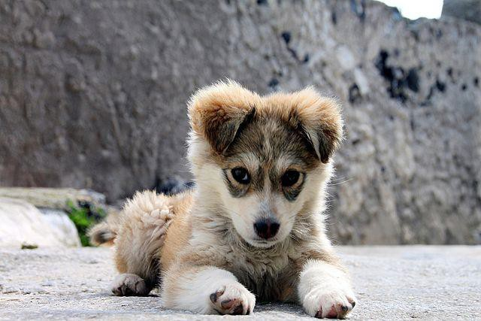
Comparing Boxes: Intersection over Union (IoU)
How can we compare our
prediction to the ground-truth box?
Our Prediction
Ground Truth
Puppy image is licensed under CC-A 2.0 Generic license. Bounding boxes and text added by Justin Johnson.

Slide 37
Comparing Boxes: Intersection over Union (IoU)
How can we compare our
prediction to the ground-truth box?
Our Prediction
Ground Truth
Intersection over Union (IoU) (Also called “Jaccard similarity” or “Jaccard index”):
𝑨𝒓𝒆𝒂 𝒐𝒇 𝑰𝒏𝒕𝒆𝒓𝒔𝒆𝒄𝒕𝒊𝒐𝒏
𝑨𝒓𝒆𝒂 𝒐𝒇 𝑼𝒏𝒊𝒐𝒏
Puppy image is licensed under CC-A 2.0 Generic license. Bounding boxes and text added by Justin Johnson.

Slide 38
Comparing Boxes: Intersection over Union (IoU)
How can we compare our
prediction to the ground-truth box?
Our Prediction
 | IoU = 0.54
Ground Truth
Intersection over Union (IoU) (Also called “Jaccard similarity” or “Jaccard index”):
𝑨𝒓𝒆𝒂 𝒐𝒇 𝑰𝒏𝒕𝒆𝒓𝒔𝒆𝒄𝒕𝒊𝒐𝒏
𝑨𝒓𝒆𝒂 𝒐𝒇 𝑼𝒏𝒊𝒐𝒏
IoU > 0.5 is “decent”
Puppy image is licensed under CC-A 2.0 Generic license. Bounding boxes and text added by Justin Johnson.

Slide 39
Comparing Boxes: Intersection over Union (IoU)
How can we compare our
Our Prediction
prediction to the ground-truth box?
 | IoU = 0.71
Ground Truth
Intersection over Union (IoU) (Also called “Jaccard similarity” or “Jaccard index”):
𝑨𝒓𝒆𝒂 𝒐𝒇 𝑰𝒏𝒕𝒆𝒓𝒔𝒆𝒄𝒕𝒊𝒐𝒏
𝑨𝒓𝒆𝒂 𝒐𝒇 𝑼𝒏𝒊𝒐𝒏
IoU > 0.5 is “decent”,
IoU > 0.7 is “pretty good”,
Puppy image is licensed under CC-A 2.0 Generic license. Bounding boxes and text added by Justin Johnson.

Slide 40
Comparing Boxes: Intersection over Union (IoU)
How can we compare our
Our Prediction
prediction to the ground-truth box?
Ground Truth
Intersection over Union (IoU) (Also called “Jaccard similarity” or “Jaccard index”):
IoU = 0.91
𝑨𝒓𝒆𝒂 𝒐𝒇 𝑰𝒏𝒕𝒆𝒓𝒔𝒆𝒄𝒕𝒊𝒐𝒏
𝑨𝒓𝒆𝒂 𝒐𝒇 𝑼𝒏𝒊𝒐𝒏
IoU > 0.5 is “decent”,
IoU > 0.7 is “pretty good”,
IoU > 0.9 is “almost perfect”
Puppy image is licensed under CC-A 2.0 Generic license. Bounding boxes and text added by Justin Johnson.

Slide 41
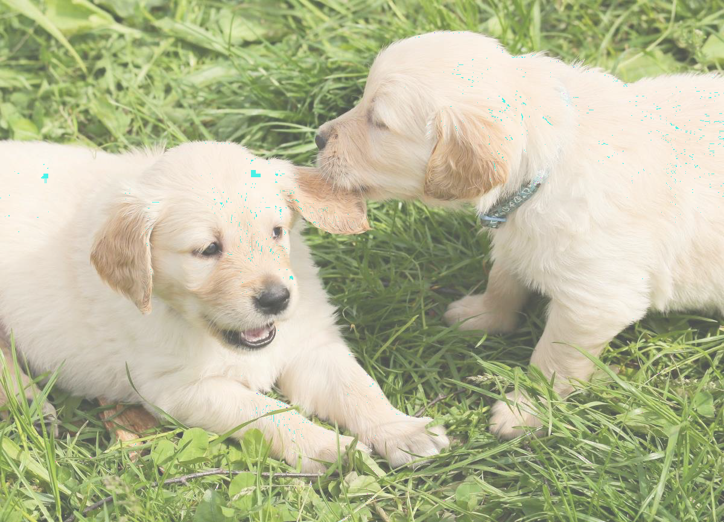
Overlapping Boxes
Problem: Object detectors often
output many overlapping detections:
P(dog) = 0.75
P(dog) = 0.9
P(dog) = 0.7
P(dog) = 0.8
Puppy image is CC0 Public Domain

Slide 42
Overlapping Boxes: Non-Max Suppression
Proble⁽m^{N}: O^{M}bje^{S}c⁾t detectors often output many overlapping detections:
P(dog) = 0.75
P(dog) = 0.9
Solution: Post-process raw detections using Non-Max Suppression (NMS)
Select next highest-scoringbox
Eliminate lower-scoring boxes
with IoU > threshold (e.g. 0.7)
If any boxes remain, GOTO 1
P(dog) = 0.7
P(dog) = 0.8
Puppy image is CC0 Public Domain

Slide 43
Overlapping Boxes: Non-Max Suppression
Proble⁽m^{N}: O^{M}bje^{S}c⁾t detectors often output many overlapping detections:
P(dog) = 0.9
P(dog) = 0.75
Solution: Post-process raw detections using Non-Max Suppression (NMS)
Select next highest-scoringbox
Eliminate lower-scoring boxes
with IoU > threshold (e.g. 0.7)
If any boxes remain, GOTO 1
IoU(■, ■) = 0.78
IoU(■, ■) = 0.05
IoU(■, ■) = 0.07
P(dog) = 0.7
P(dog) = 0.8
Puppy image is CC0 Public Domain

Slide 44
Overlapping Boxes: Non-Max Suppression
Proble⁽m^{N}: O^{M}bje^{S}c⁾t detectors often output many overlapping detections:
Solution: Post-process raw detections using Non-Max Suppression (NMS)
Select next highest-scoring box
Eliminate lower-scoring boxes
with IoU > threshold (e.g. 0.7)
If any boxes remain, GOTO 1
IoU(■, ■) = 0.74
P(dog) = 0.9 | P(dog) = 0.75
 | P(dog) = 0.7
Puppy image is CC0 Public Domain

Slide 45
Overlapping Boxes: Non-Max Suppression
Proble⁽m^{N}: O^{M}bje^{S}c⁾t detectors often output many overlapping detections:
P(dog) = 0.75
P(dog) = 0.9
Solution: Post-process raw detections using Non-Max Suppression (NMS)
Select next highest-scoringbox
Eliminate lower-scoring boxes
with IoU > threshold (e.g. 0.7)
If any boxes remain, GOTO 1
Puppy image is CC0 Public Domain

Slide 46

Overlapping Boxes: Non-Max Suppression (NMS)
Problem: Object detectors often output many overlapping detections: Solution: Post-process raw detections using Non-Max Suppression (NMS)
Select next highest-scoringbox
Eliminate lower-scoring boxes
with IoU > threshold (e.g. 0.7)
If any boxes remain, GOTO 1
Problem: NMS may eliminate ”good” boxes when objects are highly overlapping… no good solution =(
Crowd image is free for commercial use under the Pixabay license

Slide 47
Evaluating Object Detectors: Mean Average Precision (mAP)
Run object detector on all test images (with NMS)
For each category, compute Average Precision (AP) = area under Precision vs Recall Curve (AUPRC = Area Under Precision vs Recall Curve)
Notes:
NMS = non max suppression method; use to eliminate duplicate detection boxes.

Slide 48
Evaluating Object Detectors: Mean Average Precision (mAP)
All dog detections sorted by score
0.99
0.95
0.90
0.5
0.10
Run object detector on all test images (with NMS)
For each category, compute Average Precision (AP) = area under Precision vs Recall Curve
For each detection (highest score to lowest score)
All ground-truthdog boxes

Slide 49
Evaluating Object Detectors: Mean Average Precision (mAP)
All dog detections sorted by score
0.99
0.95
0.90
0.5
0.10
Match: IoU > 0.5
Run object detector on all test images (with NMS)
For each category, compute Average Precision (AP) = area under Precision vs Recall Curve
For each detection (highest score to lowest score)
If it matches some GT box with IoU > 0.5,
mark it as positive and eliminate the GT
Otherwise mark it as negative
All ground-truthdog boxes

Slide 50

Evaluating Object Detectors: Mean Average Precision (mAP)
All dog detections sorted by score
0.99
0.95
0.90
0.5
0.10
Match: IoU > 0.5
Run object detector on all test images (with NMS)
For each category, compute Average Precision (AP) = area under Precision vs Recall Curve
For each detection (highest score to lowest score)
If it matches some GT box with IoU > 0.5,
mark it as positive and eliminate the GT
Otherwise mark it as negative
Plot a point on PR Curve
All ground-truthdog boxes
Precision = 1/1 = 1.0 Recall = 1/3 = 0.33
Precision
Recall
Notes:
Precision = a fraction of the detection that are actually true.
Recall is a fraction of the ground truth we hit

Slide 51

Evaluating Object Detectors: Mean Average Precision (mAP)
All dog detections sorted by score
0.99
0.95
0.90
0.5
0.10
Match: IoU > 0.5
Run object detector on all test images (with NMS)
For each category, compute Average Precision (AP) = area under Precision vs Recall Curve
For each detection (highest score to lowest score)
If it matches some GT box with IoU > 0.5,
mark it as positive and eliminate the GT
Otherwise mark it as negative
Plot a point on PR Curve
All ground-truthdog boxes
Precision = 2/2 = 1.0 Recall = 2/3 = 0.67
Precision
Recall
Notes:
2 detection, both positive, = Precision = 2/2= 1.

Slide 52
Evaluating Object Detectors: Mean Average Precision (mAP)
All dog detections sorted by score
0.99
0.95
0.90
0.5
0.10
No match > 0.5 IoU with GT
Run object detector on all test images (with NMS)
For each category, compute Average Precision (AP) = area under Precision vs Recall Curve
For each detection (highest score to lowest score)
If it matches some GT box with IoU > 0.5,
mark it as positive and eliminate the GT
Otherwise mark it as negative
Plot a point on PR Curve
All ground-truthdog boxes
Precision = 2/3 = 0.67 Recall = 2/3 = 0.67
Precision
Recall
Notes:
Precision = true positive/positive = 2/3

Slide 53
Evaluating Object Detectors: Mean Average Precision (mAP)
All dog detections sorted by score
0.99
0.95
0.90
0.5
0.10
No match > 0.5 IoU with GT
Run object detector on all test images (with NMS)
For each category, compute Average Precision (AP) = area under Precision vs Recall Curve
For each detection (highest score to lowest score)
If it matches some GT box with IoU > 0.5,
mark it as positive and eliminate the GT
Otherwise mark it as negative
Plot a point on PR Curve
All ground-truthdog boxes
Precision = 2/4 = 0.5 Recall = 2/3 = 0.67
Precision
Recall
Notes:
Green = true positive samples; red = false positive; blue = not yet tested.

Slide 54

Evaluating Object Detectors: Mean Average Precision (mAP)
All dog detections sorted by score
0.99
0.95
0.90
0.5
0.10
Match: > 0.5 IoU
Run object detector on all test images (with NMS)
For each category, compute Average Precision (AP) = area under Precision vs Recall Curve
For each detection (highest score to lowest score)
If it matches some GT box with IoU > 0.5,
mark it as positive and eliminate the GT
Otherwise mark it as negative
Plot a point on PR Curve
All ground-truthdog boxes
Precision = 3/5 = 0.6 Recall = 3/3 = 1.0
Precision
Recall

Slide 55
Evaluating Object Detectors: Mean Average Precision (mAP)
All dog detections sorted by score
0.99
0.95
0.90
0.5
0.10
Run object detector on all test images (with NMS)
For each category, compute Average Precision (AP) = area under Precision vs Recall Curve
For each detection (highest score to lowest score)
If it matches some GT box with IoU > 0.5,
mark it as positive and eliminate the GT
Otherwise mark it as negative
Plot a point on PR Curve
Average Precision (AP) = area under PR curve
All ground-truthdog boxes
Precision
Dog AP = 0.86
Recall
Notes:
Area under Prevision v recall curve needs (AUPRC) must be between 0 and 1; the higher the number the better.

Slide 56
Evaluating Object Detectors: Mean Average Precision (mAP)
All dog detections sorted by score
0.99
0.95
0.90
0.5
0.10
Run object detector on all test images (with NMS)
For each category, compute Average Precision (AP) = area under Precision vs Recall Curve
For each detection (highest score to lowest score)
If it matches some GT box with IoU > 0.5,
mark it as positive and eliminate the GT
Otherwise mark it as negative
Plot a point on PR Curve
Average Precision (AP) = area under PR curve
How to get AP = 1.0: Hit all GT boxes with IoU > 0.5, and have no “false positive” detections ranked above any “true positives”
All ground-truthdog boxes
Precision
Dog AP = 0.86
Recall
1.0

Slide 57
Evaluating Object Detectors: Mean Average Precision (mAP)
Run object detector on all test images (with NMS)
For each category, compute Average Precision (AP) = area under Precision vs Recall Curve
For each detection (highest score to lowest score)
If it matches some GT box with IoU > 0.5,
mark it as positive and eliminate the GT
Otherwise mark it as negative
Plot a point on PR Curve
Average Precision (AP) = area under PR curve
Mean Average Precision (mAP) = average of AP for
each category
Car AP = 0.65 Cat AP = 0.80 Dog AP = 0.86
mAP@0.5 = 0.77

Slide 58
Evaluating Object Detectors: Mean Average Precision (mAP)
Run object detector on all test images (with NMS)
For each category, compute Average Precision (AP) = area under Precision vs Recall Curve
For each detection (highest score to lowest score)
If it matches some GT box with IoU > 0.5,
mark it as positive and eliminate the GT
Otherwise mark it as negative
Plot a point on PR Curve
Average Precision (AP) = area under PR curve
Mean Average Precision (mAP) = average of AP for
each category
For “COCO mAP”: Compute mAP@thresh for each IoU threshold (0.5, 0.55, 0.6, …, 0.95) and take average
mAP@0.5 = 0.77
mAP@0.55 = 0.71
mAP@0.60 = 0.65
…
mAP@0.95 = 0.2
COCO mAP = 0.4
Notes:
You can pick different IoU thresholds.
Object detection papers often report this mean average precision paper; a certain threshold is often required to get published.

Slide 59
R-CNN: Region-Based
Classify each region
CNN
Bounding box regression:
Predict “transform” to correct the
RoI: 4 numbers (t_{x}, t_{y}, t_{h}, t_{w})
Bbox
Class
Bbox
Class
Bbox
Class
Forward each region through ConvNet
Conv Net
Conv
Net
Conv Net
Warped image regions (224x224)
Regions of
Interest (RoI) from a proposal method (~2k)
Input
image
Girshick et al, “Rich feature hierarchies for accurate object detection and
semantic segmentation”, CVPR 2014.
Figure copyright Ross Girshick, 2015; source. Reproduced with permission.
Notes:
To get the regions shown above, you need to do selective search to generate these bounding box regions; this is done by the GPU
There are 2k Regions of Interest, and each region of interest you would need to run a Conv Net model – this is too expensive.

Slide 60
R-CNN: Region-Based
Classify each region
CNN
Bounding box regression:
Predict “transform” to correct the
RoI: 4 numbers (t_{x}, t_{y}, t_{h}, t_{w})
Bbox
Class
Bbox
Class
Bbox
Class
Forward each region through ConvNet
Conv Net
Problem: Very slow! Need to do ~2k forward passes for each image!
Conv
Net
Conv Net
Warped image regions (224x224)
Regions of
Interest (RoI) from a proposal method (~2k)
Input
image
Girshick et al, “Rich feature hierarchies for accurate object detection and
semantic segmentation”, CVPR 2014.
Figure copyright Ross Girshick, 2015; source. Reproduced with permission.

Slide 61
R-CNN: Region-Based
Classify each region
CNN
Bounding box regression:
Predict “transform” to correct the
RoI: 4 numbers (t_{x}, t_{y}, t_{h}, t_{w})
Bbox
Class
Bbox
Class
Bbox
Class
Forward each region through ConvNet
Conv Net
Problem: Very slow! Need to do ~2k forward passes for each image!
Conv
Net
Conv Net
Warped image regions (224x224)
Solution: Run CNN
*before* warping!
Regions of
Interest (RoI) from a proposal method (~2k)
Input
image
Girshick et al, “Rich feature hierarchies for accurate object detection and
semantic segmentation”, CVPR 2014.
Figure copyright Ross Girshick, 2015; source. Reproduced with permission.

Slide 62






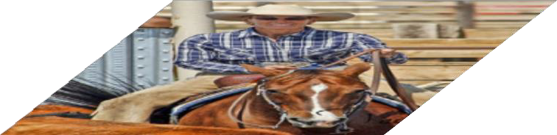
“Slow” R-CNN
Process each region independently
Bbox
Class
Bbox
Class
Bbox
Class
Conv Net
Conv Net
Conv Net
Input image

Slide 63

Fast R-
CNN
“Slow” R-CNN
Process each region independently
Bbox
Class
Bbox
Class
Bbox
Class
Conv Net
Conv Net
Conv Net
Input
image
Input image
Girshick, “Fast R-CNN”, ICCV 2015. Figure copyright Ross Girshick, 2015; source. Reproduced with permission.
Notes:
Fast R-CNN is same as slow RCNN, but we swap the warp and conv net stages.
First train, THEN warp = faster R-CNN

Slide 64
Fast R-
CNN
“Slow” R-CNN
Process each region independently
Bbox
Class
Bbox
Class
Bbox
Class
Image features
Conv Net
Conv Net
“Backbone” network: AlexNet, VGG, ResNet, etc
Run whole image
through ConvNet
Conv Net
ConvNet
Input
image
Input image
Girshick, “Fast R-CNN”, ICCV 2015. Figure copyright Ross Girshick, 2015; source. Reproduced with permission.

Slide 65
Fast R-
CNN
“Slow” R-CNN
Process each region independently
Regions of Interest (RoIs) from a proposal method
Bbox
Class
Bbox
Class
Bbox
Class
Image features
Conv Net
Conv Net
“Backbone” network: AlexNet, VGG, ResNet, etc
Run whole image
through ConvNet
Conv Net
ConvNet
Input image
Input image
Girshick, “Fast R-CNN”, ICCV 2015. Figure copyright Ross Girshick, 2015; source. Reproduced with permission.
Notes:
Proposal method = selective search

Slide 66
Fast R-
CNN
“Slow” R-CNN
Process each region independently
Regions of Interest (RoIs) from a proposal method
Bbox
Class
Crop + Resize features
Image features
Bbox
Class
Bbox
Class
Conv Net
Conv Net
“Backbone” network: AlexNet, VGG, ResNet, etc
Run whole image through ConvNet
Conv Net
ConvNet
Input image
Input image
Girshick, “Fast R-CNN”, ICCV 2015. Figure copyright Ross Girshick, 2015; source. Reproduced with permission.
Notes:
Crop + Resize features = Warping
In slow R-CNN, we do warping first then independently process each region.

Slide 67
Fast R-
CNN
“Slow” R-CNN
Process each region independently
Regions of Interest (RoIs) from a proposal method
Per-Region Network
CNN
CNN
CNN
Bbox
Class
Crop + Resize features Image features
Bbox
Class
Bbox
Class
Conv Net
Conv Net
“Backbone” network: AlexNet, VGG, ResNet, etc
Run whole image
through ConvNet
Conv Net
ConvNet
Input image
Input image
Girshick, “Fast R-CNN”, ICCV 2015. Figure copyright Ross Girshick, 2015; source. Reproduced with permission.

Slide 68
Fast R-
CNN
Bbox
Bbox
Bbox
Category and box transform per region
“Slow” R-CNN
Process each region independently
Class
Class
Class
Regions of Interest (RoIs) from a proposal method
Per-Region Network
CNN
CNN
CNN
Bbox
Class
Crop + Resize features Image features
Bbox
Class
Bbox
Class
Conv Net
Conv Net
“Backbone” network: AlexNet, VGG, ResNet, etc
Run whole image
through ConvNet
Conv Net
ConvNet
Input image
Input image
Girshick, “Fast R-CNN”, ICCV 2015. Figure copyright Ross Girshick, 2015; source. Reproduced with permission.

Slide 69
Fast R-
CNN
Bbox
Bbox
Bbox
Category and box transform per region
Class
Class
Class
Per-Region network is relatively lightweight
Regions of Interest (RoIs) from a proposal method
Per-Region Network
CNN
CNN
CNN
Crop + Resize features Image features
“Backbone” network: AlexNet, VGG, ResNet, etc
Run whole image
through ConvNet
Most of the computation happens in backbone network; this saves work for overlapping region proposals
ConvNet
Input image
Girshick, “Fast R-CNN”, ICCV 2015. Figure copyright Ross Girshick, 2015; source. Reproduced with permission.

Slide 70
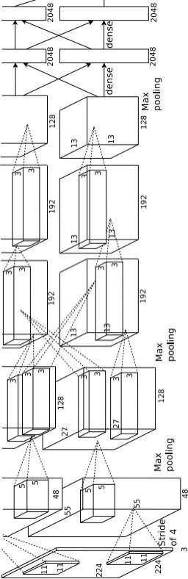
Fast R-
CNN
Bbox
Bbox
Bbox
Category and box transform per region
Example: When using AlexNet for detection, five conv layers are used for backbone and
two FC layers are
used for per-
region network
Class
Class
Class
Regions of Interest (RoIs) from a proposal method
Per-Region Network
CNN
CNN
CNN
Crop + Resize features Image features
“Backbone” network: AlexNet, VGG, ResNet, etc
Run whole image through ConvNet
ConvNet
Input image
Girshick, “Fast R-CNN”, ICCV 2015. Figure copyright Ross Girshick, 2015; source. Reproduced with permission.

Slide 71
Fast R-
3x3 conv, 512
3x3 conv, 512
3x3 conv, 512
3x3 conv, 512
3x3 conv, 512
3x3 conv, 512, /2
Softmax
CNN
FC 1000
Pool
Bbox
Bbox
Bbox
Category and box transform per region
Example:
For ResNet, last stage is used as per-region network; the rest of the network is used as backbone
Class
Class
Class
Regions of Interest (RoIs) from a proposal method
Per-Region Network
CNN
CNN
CNN
..
Crop + Resize features Image features
.
3x3 conv, 128
3x3 conv, 128
3x3 conv, 128
3x3 conv, 128
“Backbone” network: AlexNet, VGG, ResNet, etc
Run whole image through ConvNet
3x3 conv, 128
3x3 conv, 128, / 2
3x3 conv, 64
3x3 conv, 64
ConvNet
3x3 conv, 64
3x3 conv, 64
3x3 conv, 64
3x3 conv, 64
Pool
7x7 conv, 64, / 2
Input
Input image
Girshick, “Fast R-CNN”, ICCV 2015. Figure copyright Ross Girshick, 2015; source. Reproduced with permission.
Notes:
Although if you perform warping before running entire CNN there will be less data input since regions are smaller, computation is still heavy.
So doing backbone for entire image first before warping and then finishing the training of those warped regions will much less layers is still faster even though the initial backbone training does include much larger input since we run the entire image through the backbone.

Slide 72
Fast R-
CNN
Bbox
Bbox
Bbox
Category and box transform per region
Class
Class
Class
Regions of Interest (RoIs) from a proposal method
Per-Region Network
CNN
CNN
CNN
Crop + Resize features
Image features
How to crop features?
“Backbone” network: AlexNet, VGG, ResNet, etc
Run whole image through ConvNet
ConvNet
Input image
Girshick, “Fast R-CNN”, ICCV 2015. Figure copyright Ross Girshick, 2015; source. Reproduced with permission.

Slide 73
Cropping Features: RoI Pool
Input Image
(e.g. 3 x 640 x 480)
Girshick, “Fast R-CNN”, ICCV 2015.

Slide 74
Cropping Features: RoI Pool
CNN
Input Image
(e.g. 3 x 640 x 480)
Image features
(e.g. 512 x 20 x 15)
Girshick, “Fast R-CNN”, ICCV 2015.

Slide 75
Cropping Features: RoI Pool
Project proposal onto features
CNN
Input Image
(e.g. 3 x 640 x 480)
Image features
(e.g. 512 x 20 x 15)
Girshick, “Fast R-CNN”, ICCV 2015.

Slide 76
Cropping Features: RoI Pool
“Snap” to
Project proposal onto features
grid cells
CNN
Input Image
(e.g. 3 x 640 x 480)
Image features
(e.g. 512 x 20 x 15)
Girshick, “Fast R-CNN”, ICCV 2015.

Slide 77
Cropping Features: RoI Pool
Divide into 2x2 grid of (roughly) equal subregions
“Snap” to
Project proposal onto features
grid cells
CNN
Input Image
(e.g. 3 x 640 x 480)
Image features
(e.g. 512 x 20 x 15)
Girshick, “Fast R-CNN”, ICCV 2015.

Slide 78
Cropping Features: RoI Pool
Divide into 2x2 grid of (roughly) equal subregions
grid cells
“Snap” to
Project proposal
onto features
Max-pool within each subregion
CNN
Region features (here 512 x 2 x 2;
In practice e.g 512 x 7 x 7)
Input Image
(e.g. 3 x 640 x 480)
Image features
(e.g. 512 x 20 x 15)
Region features always the same size even if input regions have different sizes!
Girshick, “Fast R-CNN”, ICCV 2015.

Slide 79
Cropping Features: RoI Pool
Divide into 2x2 grid of (roughly) equal subregions
“g^{S}ri^{n}dªc^{p}e”ll^{t}sº
Project proposal onto features
Max-pool within each subregion
CNN
Region features (here 512 x 2 x 2;
In practice e.g 512 x 7 x 7)
Input Image
(e.g. 3 x 640 x 480)
Image features
(e.g. 512 x 20 x 15)
Region features always the same size even if input regions have different sizes!
Problem: Slight misalignment due to snapping; different-sized subregions is weird
Girshick, “Fast R-CNN”, ICCV 2015.
Notes:
Maxpool within each subregion: split each region into superpixels (number of pixels that region contains) and select the largest value.

Slide 80
Cropping Features: RoI Align
Divide into equal-sized subregions (may not be aligned to grid!)
No “snapping”!
Project proposal onto features
CNN
Input Image
(e.g. 3 x 640 x 480)
Image features
(e.g. 512 x 20 x 15)
He et al, “Mask R-CNN”, ICCV 2017

Slide 81


Cropping Features: RoI Align
Divide into equal-sized subregions (may not be aligned to grid!)
No “snapping”!
Sample features at regularly-spaced points in each subregion using bilinear interpolation
Project proposal
onto features
CNN
Input Image
(e.g. 3 x 640 x 480)
Image features
(e.g. 512 x 20 x 15)
He et al, “Mask R-CNN”, ICCV 2017

Slide 82


Cropping Features: RoI Align
Divide into equal-sized subregions (may not be aligned to grid!)
No “snapping”!
Sample features at regularly-spaced points in each subregion using bilinear interpolation
Project proposal
onto features
CNN
Input Image
(e.g. 3 x 640 x 480)
Image features
(e.g. 512 x 20 x 15)
Feature f_{xy} for point (x, y) is a
linear combination of features
at its four neighboring grid cells:

Slide 83
Cropping Features: RoI Align
Divide into equal-sized subregions (may not be aligned to grid!)
No “snapping”!
Sample features at regularly-spaced points in each subregion using bilinear interpolation
^{f}6,5 ^{f}7,5
Project proposal
onto features
CNN
^{f}6.5,5.8
^{f}6,6 ^{f}7,6
Feature f_{xy} for point (x, y) is a
linear combination of features
at its four neighboring grid cells:

Slide 84
Cropping Features: RoI Align
Divide into equal-sized subregions (may not be aligned to grid!)
No “snapping”!
Sample features at regularly-spaced points in each subregion using bilinear interpolation
^{f}6,5 ^{f}7,5
Project proposal
onto features
CNN
^{f}6.5,5.8
^{f}6,6
^{f}7,6
f_{6.5,5.8} = (f_{6,5} * 0.5 * 0.2) + (f_{7,5} * 0.5 * 0.2)
Feature f_{xy} for point (x, y) is a
linear combination of features
at its four neighboring grid cells:
+ (f
* 0.5 * 0.8) + (f
6,6
7,6

Slide 85
Cropping Features: RoI Align
Divide into equal-sized subregions (may not be aligned to grid!)
No “snapping”!
Sample features at regularly-spaced points in each subregion using bilinear interpolation
^{f}6,5 ^{f}7,5
Project proposal
onto features
CNN
0.8
0.5
f
6.5,5.8
^{f}6,6
^{f}7,6
f_{6.5,5.8} = (f_{6,5} * 0.5 * 0.2) + (f_{7,5} * 0.5 * 0.2)
Feature f_{xy} for point (x, y) is a
linear combination of features
at its four neighboring grid cells:
+ (f
* 0.5 * 0.8) + (f
6,6
7,6

Slide 86
Cropping Features: RoI Align
Divide into equal-sized subregions (may not be aligned to grid!)
No “snapping”!
Sample features at regularly-spaced points in each subregion using bilinear interpolation
^{f}6,5 ^{f}7,5
Project proposal
onto features
CNN
0.8
^{f}6.5,5.8
0.5
^{f}6,6
^{f}7,6
Feature f_{xy} for point (x, y) is a linear combination of features at its four neighboring grid cells:
f_{6.5,5.8} = (f_{6,5} * 0.5 * 0.2) + (f_{7,5} * 0.5 * 0.2)
+ (f * 0.5 * 0.8) + (f
6,6 7,6

Slide 87
Cropping Features: RoI Align
Divide into equal-sized subregions (may not be aligned to grid!)
No “snapping”!
Sample features at regularly-spaced points in each subregion using bilinear interpolation
^{f}6,5 ^{f}7,5
Project proposal
onto features
CNN
_{0.2} 0.5
^{f}6,6
^{f}6.5,5.8
^{f}7,6
f_{6.5,5.8} = (f_{6,5} * 0.5 * 0.2) + (f_{7,5} * 0.5 * 0.2)
+ (f_{6,6} * 0.5 * 0.8) + (f_{7,6} * 0.5 * 0.8)
Feature f_{xy} for point (x, y) is a
linear combination of features
at its four neighboring grid cells:

Slide 88
Cropping Features: RoI Align
Divide into equal-sized subregions (may not be aligned to grid!)
No “snapping”!
Sample features at regularly-spaced points in each subregion using bilinear interpolation
^{f}6,5 ^{f}7,5
Project proposal
onto features
CNN
^{f}6.5,5.8
0.2
^{f}6,6
0.5 f_{7,6}
f_{6.5,5.8} = (f_{6,5} * 0.5 * 0.2) + (f_{7,5} * 0.5 * 0.2)
+ (f_{6,6} * 0.5 * 0.8) + (f_{7,6} * 0.5 * 0.8)
Feature f_{xy} for point (x, y) is a
linear combination of features
at its four neighboring grid cells:

Slide 89
Cropping Features: RoI Align
Divide into equal-sized subregions (may not be aligned to grid!)
No “snapping”!
Sample features at regularly-spaced points in each subregion using bilinear interpolation
^{f}6,5 ^{f}7,5
Project proposal
onto features
CNN
^{f}6.5,5.8
^{f}6,6 ^{f}7,6
Feature f_{xy} for point (x, y) is a linear combination of features at its four neighboring grid cells:
This is differentiable! Upstream gradient for sampled feature will
flow backwardinto each of the four nearest-neighbor gridpoints

Slide 90
Cropping Features: RoI Align
Divide into equal-sized subregions (may not be aligned to grid!)
No “snapping”!
Sample features at regularly-spaced points in each subregion using bilinear interpolation
After sampling, max-
pool in each subregion
Project proposal
onto features
CNN
Region features (here 512 x 2 x 2;
In practice e.g 512 x 7 x 7)
Input Image
(e.g. 3 x 640 x 480)
Image features
(e.g. 512 x 20 x 15)
He et al, “Mask R-CNN”, ICCV 2017

Slide 91















Fast R-CNN vs “Slow” R- CNN
Fast R-CNN: Apply differentiable
cropping to shared image features
“Slow” R-CNN: Apply differentiable cropping to shared image features
Bbox
Bbox
Bbox
Category and box transform per region
Bbox
Class
Class
Class
Class
Bbox
Class
Regionsof Interest (RoIs) from a proposal method
Per-Region Network
Bbox
Class
Forward each region through ConvNet
CNN
CNN
CNN
Conv Net
Crop + Resize features Image features
Conv Net
Conv Net
Warped image regions (224x224)
“Backbone” network: AlexNet, VGG, ResNet, etc
Run whole image through ConvNet
Regions of
Interest (RoI) from a proposal method (~2k)
ConvNet
Input image
Input image
Notes:
Main difference: Swap order of convolutional operation and warping (cropping and resizing) operations.
Fast r-cnn then completes the rest of the CNN after backbone CNN of the entire image.

Slide 92
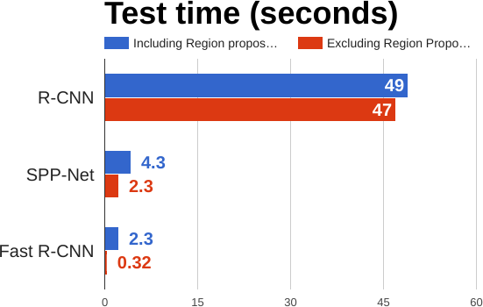
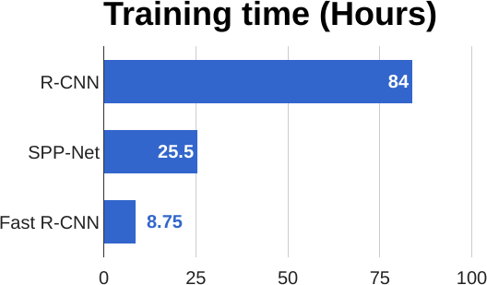
Fast R-CNN vs “Slow” R- CNN
Girshick et al, “Rich feature hierarchies for accurate object detection and semantic segmentation”, CVPR 2014.
He et al, “Spatial pyramidpooling in deep convolutional networks for visual recognition”, ECCV 2014
Girshick, “Fast R-CNN”, ICCV 2015

Slide 93
Fast R-CNN vs “Slow” R- CNN
Problem: Runtime dominated by region proposals!
Girshick et al, “Rich feature hierarchies for accurate object detection and semantic segmentation”, CVPR 2014.
He et al, “Spatial pyramidpooling in deep convolutional networks for visual recognition”, ECCV 2014
Girshick, “Fast R-CNN”, ICCV 2015

Slide 94
Fast R-CNN vs “Slow” R- CNN
Problem: Runtime dominated by region proposals!
Recall: Region proposals computed by heuristic ”Selective Search” algorithm on CPU -- let’s learn them with a CNN instead!
Girshick et al, “Rich feature hierarchies for accurate object detection and semantic segmentation”, CVPR 2014.
He et al, “Spatial pyramidpooling in deep convolutional networks for visual recognition”, ECCV 2014
Girshick, “Fast R-CNN”, ICCV 2015
Notes:
Not only is fast R-CNN trained and gives output faster, it is also more accurate!

Slide 95
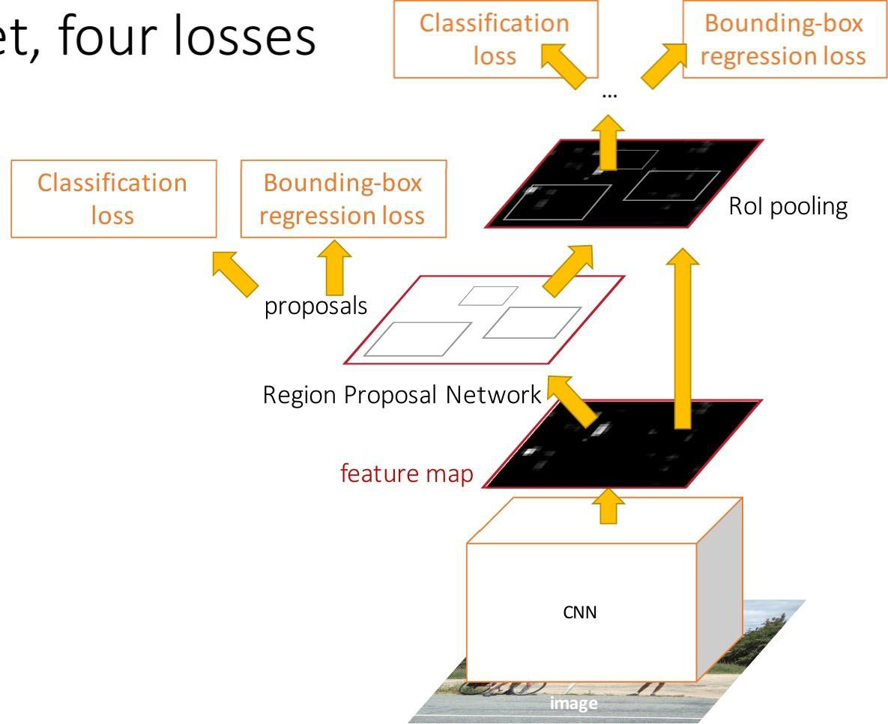
Faster R-CNN: Learnable Region
Proposals
Insert Region Proposal Network (RPN) to predict proposals from features
Otherwise same as Fast R-CNN: Crop features for each proposal, classify each one
Ren et al, “Faster R-CNN: Towards Real-Time Object Detection with Region Proposal Networks”, NIPS 2015 Figure copyright 2015, Ross Girshick; reproduced with permission
Notes:
The selective search is not very efficient and hard to parallelize (and is done by GPU).
It is mostly separate from the deep learning part.
Now, selective search heuristic algorithm is being replaced by trained deep neural nets (called Region Proposal Network) because they are faster and more accurate for predicting/generating regions of interest (bounding boxes).

Slide 96
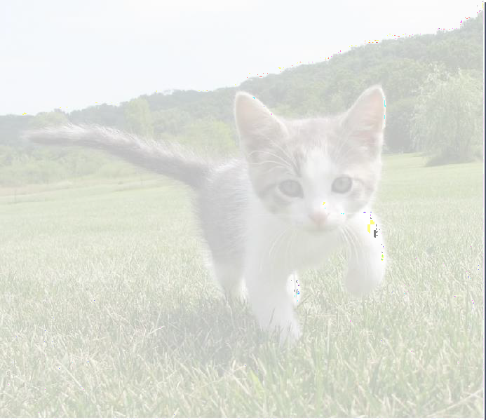
Region Proposal Network
(RPN)
Run backbone CNN to get
features aligned to input image
CNN
Input Image
(e.g. 3 x 640 x 480)
Image features
(e.g. 512 x 20 x 15)

Slide 97
Imagine an anchor box of fixed size at each point in the feature map
Region Proposal Network (RPN)
Run backbone CNN to get features aligned to input image
CNN
Input Image
(e.g. 3 x 640 x 480)
Image features
(e.g. 512 x 20 x 15)
Notes:
We have 20x15 = 300 super pixels; thus we will have 300 anchor boxes respectively.

Slide 98
Imagine an anchor box of fixed size at each point in the feature map
Region Proposal Network (RPN)
Run backbone CNN to get features aligned to input image
Anchor is an object?
1 x 20 x 15
CNN
Conv
At each point, predict whether the corresponding anchor contains an object (per-cell logistic regression, predict scores with conv layer)
Input Image (e.g. 3 x 640 x 480)
Image features (e.g. 512 x 20 x 15)

Slide 99
Imagine an anchor box of fixed size at each point in the feature map
Region Proposal Network (RPN)
Run backbone CNN to get features aligned to input image
Anchor is an object?
1 x 20 x 15
CNN
Conv
Box transforms 4 x 20 x 15
Input Image (e.g. 3 x 640 x 480)
For positive boxes, also predict a box transform to regress from anchor box to object box
Image features (e.g. 512 x 20 x 15)
Notes:
Output a box transform for each positive anchor box
Use L2 regression loss

Slide 100
Region Proposal Network (RPN)
Problem: Anchor box may have the wrong size / shape Solution: Use K different anchor boxes at each point!
Run backbone CNN to get
features aligned to input image
Anchor is an object?
K x 20 x 15
CNN
Conv
Box transforms
4K x 20 x 15
At test time: sort all K*20*15 boxes by their score, and take the top ~300 as our region proposals
Input Image (e.g. 3 x 640 x 480)
Image features (e.g. 512 x 20 x 15)

Slide 101
Faster R-CNN: Learnable Region
Proposals
Jointly train with 4 losses:
RPN classification: anchor box is object / not an object
RPN regression: predict transform from anchor box to proposal box
Object classification: classify
proposals as background / object class
Object regression: predict transform
from proposal box to object box
Ren et al, “Faster R-CNN: Towards Real-Time Object Detection with Region Proposal Networks”, NIPS 2015 Figure copyright 2015, Ross Girshick; reproduced with permission

Slide 102
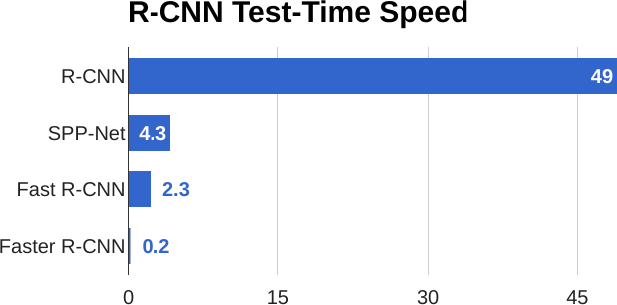
Faster R-CNN: Learnable Region Proposals

Slide 103
Faster R-CNN: Learnable Region
Proposals
Faster R-CNN is a
Two-stage object detector
First stage: Run once per image
Backbone network
Region proposal network
Second stage: Run once per region
Crop features: RoI pool / align
Predict object class
Prediction bbox offset

Slide 104
Faster R-CNN: Learnable Region
Proposals
Question: Do we really need the second stage?
Faster R-CNN is a
Two-stage object detector
First stage: Run once per image
Backbone network
Region proposal network
Second stage: Run once per region
Crop features: RoI pool / align
Predict object class
Prediction bbox offset
Notes:
Answer: we would need the Region Proposal Network to be very powerful in order to ‘skip’ (do it within the region proposal stage) the second stage.
It can be done.

Slide 105
Single-Stage Object Detection
RPN: Classify each anchor as object / not object
Single-Stage Detector: Classify
each object as one of C
Run backbone CNN to get
features aligned to input image
categories (or background)
Anchor category
(C+1) x K x 20 x 15
CNN
Conv
Box transforms 4K x 20 x 15
Input Image (e.g. 3 x 640 x 480)
Remember: K anchors at each position in image feature map
Image features (e.g. 512 x 20 x 15)
Notes:
Do full classification decision for anchor boxes
C + 1 → There are C categories, but do +1 for background as a category since we are no longer merely detecting object or not, but rather what kind of object including background being considered an object itself.
There are K anchor boxes
Total number of box transforms = 4 per anchor K = 4*K
512 channels, each composed of 20x15 super pixels.

Slide 106
Single-Stage Object Detection
RPN: Classify each anchor as object / not object
Single-Stage Detector: Classify
each object as one of C
Run backbone CNN to get
features aligned to input image
categories (or background)
Anchor category
(C+1) x K x 20 x 15
CNN
Conv
Box transforms
C x 4K x 20 x 15
Sometimes use category- specific regression: Predict different box transforms for each category
Input Image (e.g. 3 x 640 x 480)
Image features (e.g. 512 x 20 x 15)
Redmon et al, “You Only Look Once: Unified, Real-Time Object Detection”, CVPR 2016
Liu et al, “SSD: Single-Shot MultiBox Detector”, ECCV 2016
Lin et al, “Focal Loss for Dense Object Detection”, ICCV 2017

Slide 107
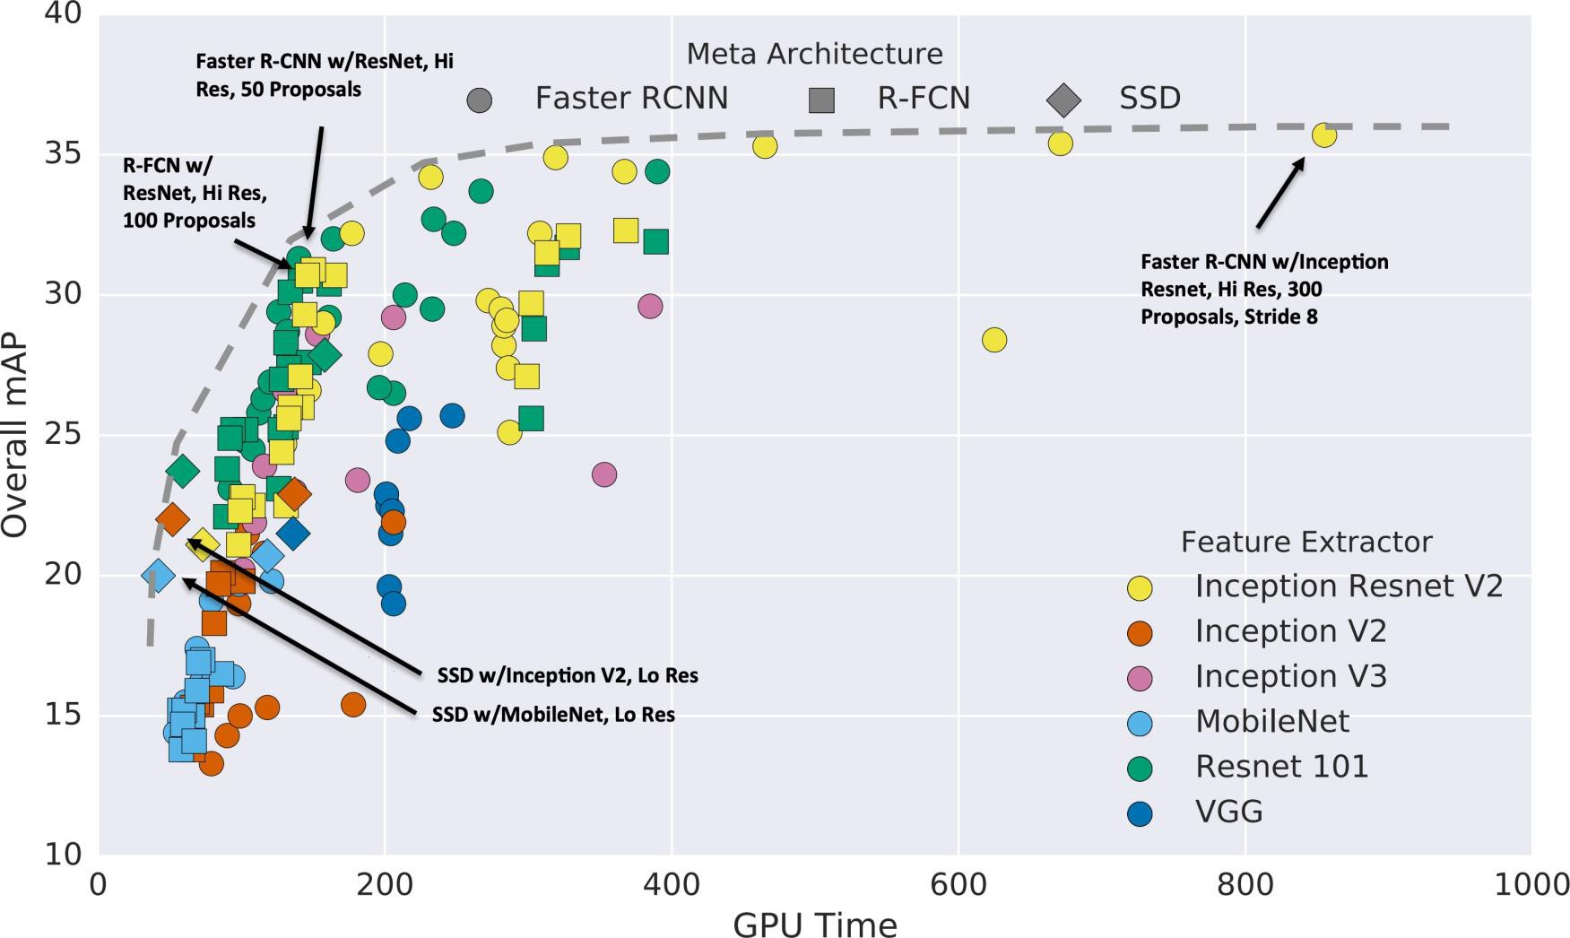
Object Detection: Lots of variables!
Huang et al, “Speed/accuracy trade-offs for modern convolutional object detectors”, CVPR 2017

Slide 108
Object Detection: Lots of variables!
Takeaways:
- Two stage method (Faster R-CNN) get the best accuracy, but are slower
Huang et al, “Speed/accuracy trade-offs for modern convolutional object detectors”, CVPR 2017
Notes:
NEED TO KNOW THIS STUFF FOR AUTONOMOUS DRIVING – DEVELOPER JOBS – NEED TO BE GOOD WITH OBJECT DETECTION WITH VISION DATA THROUGH DEEP LEARNING MODELS.

Slide 109
Object Detection: Lots of variables!
Takeaways:
Two stage method (Faster R-CNN) get the best accuracy, but are slower
Single-stage methods
(SSD) are much faster, but
don’t perform as well
Huang et al, “Speed/accuracy trade-offs for modern convolutional object detectors”, CVPR 2017
Notes:
Feature Extractor = backbone network.

Slide 110
Object Detection: Lots of variables!
Takeaways:
Two stage method (Faster R-CNN) get the best accuracy, but are slower
Single-stage methods
(SSD) are much faster, but
don’t perform as well
Bigger backbones improve
performance, but are
slower
Huang et al, “Speed/accuracy trade-offs for modern convolutional object detectors”, CVPR 2017
Notes:
Recommends reading the paper: Huang et al, “Speed/accuracy trade-offs for modern convolutional object detectors”, CVPR 2017
Note: real time prediction is important because a camera is constantly feeding in data frames that are changing; so you need rapid “real-time” computation in order to make predictions while camera is actively obtaining data that needs to be processed (i.e. facial recognition or object recognition).

Slide 111
Object Detection: Lots of variables!
These results are a few years old … since then GPUs have gotten faster, and we’ve improved performance with many tricks:
Huang et al, “Speed/accuracy trade-offs for modern convolutional object detectors”, CVPR 2017
Wu et al, Detectron2, GitHub 2019

Slide 112
Object Detection: Lots of variables!
These results are a few years old … since then GPUs have gotten faster, and we’ve improved performance with many tricks:
Faster R-CNN
w/ResNet-101-FPN,
longertraining
(63ms, 42.0 mAP)
Train longer!
Multiscale backbone: Feature Pyramid Networks
Huang et al, “Speed/accuracy trade-offs for modern convolutional object detectors”, CVPR 2017
Wu et al, Detectron2, GitHub 2019

Slide 113
Object Detection: Lots of variables!
These results are a few years old … since then GPUs have gotten faster, and we’ve improved performance with many tricks:
Faster R-CNN
w/ResNet-101-FPN,
Faster R-CNN
w/ResNeXt-101-
longertraining
(63ms, 42.0 mAP)
FPN, longertraining
(120ms, 43.0 mAP)
Train longer!
Multiscale backbone: Feature Pyramid Networks
Better backbone: ResNeXt
Huang et al, “Speed/accuracy trade-offs for modern convolutional object detectors”, CVPR 2017
Wu et al, Detectron2, GitHub 2019

Slide 114
Object Detection: Lots of variables!
These results are a few years old … since then GPUs have gotten faster, and we’ve improved performance with many tricks:
RetinaNet (SSD-like) w/ResNet-101
(80ms, 39.9 mAP)
Train longer!
Multiscale backbone: Feature Pyramid Networks
Better backbone: ResNeXt
Single-Stage methods have improved
Huang et al, “Speed/accuracy trade-offs for modern convolutional object detectors”, CVPR 2017
Wu et al, Detectron2, GitHub 2019

Slide 115
Object Detection: Lots of variables!
Mask R-CNN
These results are a few years old … since then GPUs have gotten faster, and we’ve improved performance with many tricks:
w/RexNeXt-152
(281 ms, 49.3 mAP)
Train longer!
Multiscale backbone: Feature Pyramid Networks
Better backbone: ResNeXt
Single-Stage methods have improved
Very big models work better
Huang et al, “Speed/accuracy trade-offs for modern convolutional object detectors”, CVPR 2017
Wu et al, Detectron2, GitHub 2019

Slide 116
Object Detection: Lots of variables!
Mask R-CNN w/RexNeXt-152 (281 ms, 49.3 mAP)
These results are a few years old … since then GPUs have gotten faster, and we’ve improved performance with many tricks:
Mask R-CNN w/RexNeXt-152
+Test-time augmentation
(? ms, 51.4 mAP)
Train longer!
Multiscale backbone: Feature Pyramid Networks
Better backbone: ResNeXt
Single-Stage methods have improved
Very big models work better
Test-time augmentation pushes
numbers up
Huang et al, “Speed/accuracy trade-offs for modern convolutional object detectors”, CVPR 2017
Wu et al, Detectron2, GitHub 2019

Slide 117
Object Detection: Lots of variables!
Current leaderboard
winner: 55 mAP Method ???
Runtime ???
Mask R-CNN w/ (281 ms, 49.
RexNeXt-1523 mAP)
These results are a few years old … since then GPUs have gotten faster, and we’ve improved performance with many tricks:
Train longer!
Multiscale backbone: Feature Pyramid Networks
Better backbone: ResNeXt
Single-Stage methods have improved
Very big models work better
Test-time augmentation pushes
numbers up
Big ensembles, more data, etc
Huang et al, “Speed/accuracy trade-offs for modern convolutional object detectors”, CVPR 2017
https://competitions.codalab.org/competitions/20794#results

Slide 118
Object Detection: Open-Source Code
Object detection is hard! Don’t implement it yourself (Unless you are working on A5…)
TensorFlow Detection API:
https://github.com/tensorflow/models/tree/master/research/object_detection
Faster R-CNN, SSD, RFCN, Mask R-CNN
Detectron2 (PyTorch):
https://github.com/facebookresearch/detectron2
Fast / Faster / Mask R-CNN, RetinaNet

Slide 119
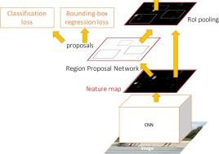



Summary
“Slow” R-CNN: Run CNN independently for each region
Fast R-CNN: Apply differentiable cropping to shared
Faster R-CNN: Compute proposals with CNN
Single-Stage:
Fully convolutional detector
image features
 | Bbox |  | Class
Class
Bbox
Bbox
Class
Conv
Net
Forward each region through ConvNet
Category and box
transform per region
Conv Net
Bbox |  | Bbox | Bbox
Class |  | Class | Class
Conv
Net
Warped image regions (224x224)
Regions of Interest (RoIs) from a proposal
method
Per-Region Network
CNN
CNN
CNN
Crop + Resize features
Image features
Input image
Regions of Interest(RoI) froma proposal method(~2k)
“Backbone” network: AlexNet, VGG, ResNet, etc
Runwhole image through ConvNet
ConvNet
Input image

